Slide 1

KISHKINDA UNIVERSITY
5W38+WVG, Siruguppa Rd, Ashok Nagar, Rajeshwari nagar, Ballari, Karnataka 583275
Department of Computer Science & Engineering
Project Presentation on
“Referee scheduling system”
Team members
1. Preetam - KUB23CSE107
2. Vikas - KUB23CSE159
3. Praveen - KUB24CSE022
4. Ganesh - KUB24CSE035
5. Prashanth - KUB24CSE062
Trainer : sukumar

Slide 2

Referee Scheduling System
This presentation outlines a proof-of-concept for a new referee scheduling system designed to streamline the management of referees for various sports organizations.

Slide 3

Problem Statement and Objectives
Current referee scheduling methods often lack efficiency, resulting in scheduling conflicts, administrative burdens, and a lack of communication.
1
Objective 1
2
Objective 2
To simplify the scheduling process for referees and organizers, improving efficiency and reducing administrative workloads.
To enhance communication between referees, organizers, and athletes, minimizing misunderstandings and delays.
3
Objective 3
To provide real-time access to scheduling information for all stakeholders, improving transparency and accountability.

Slide 4

Modules
1
Referee Management Module
- Manage referee details (e.g., name, expertise, availability).
- CRUD operations for referees (Create, Read, Update, Delete).
- Update referee availability status.
2
Scheduling Algorithm Module
- Responsibilities :
- Implement the logic to assign referees to games.
- Factor in availability, expertise, and game requirements.
- Ensure referees are not overbooked or double-booked.
3
Feedback Management Module
- Collect and manage feedback on referees' performances.
- Allow for updating and reviewing feedback.
- Use feedback to adjust referee expertise or availability

Slide 5
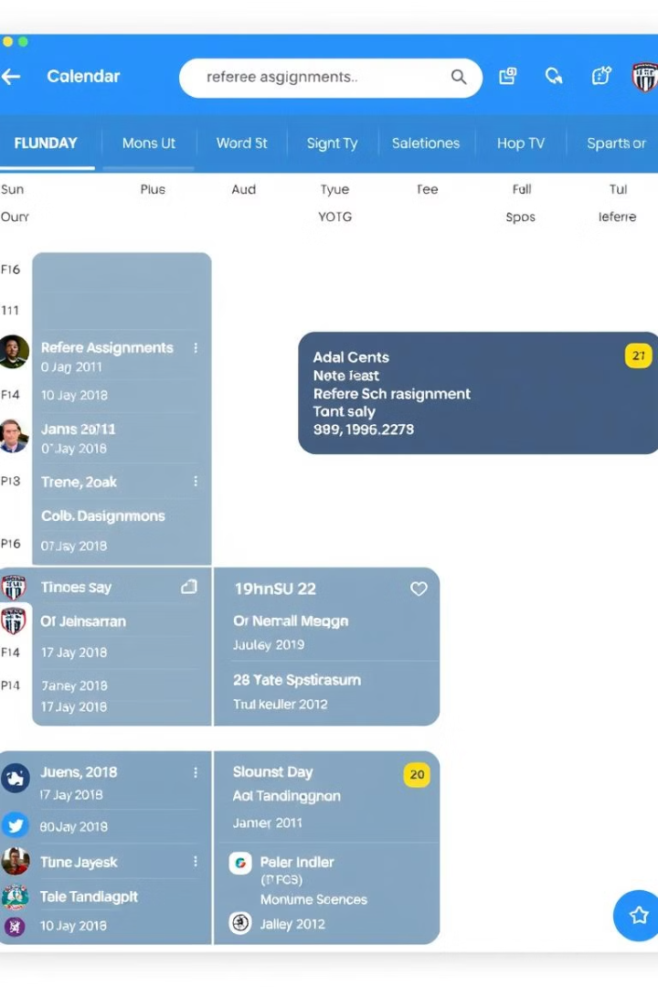
Key Features and Functionality
The system will incorporate a range of features designed to address the challenges faced by referees and organizers.
Referee Profile Management
Game Scheduling
Centralized profiles for referees with comprehensive details, including availability, qualifications, and contact information.
Streamlined game scheduling with automated assignment based on referee availability, qualifications, and preferred sports.
Communication and Notifications
Reporting and Analytics
Detailed reports on referee activity, scheduling trends, and performance metrics to improve efficiency and decision-making.
Real-time notifications for referees regarding assignments, schedule changes, and important announcements.

Slide 6
Advantages | Disadvantages
Clear Separation of Concerns | Limited Feedback Handling
Basic CRUD Operations | No Persistent Storage
Unit Testing | Absence of Admin and User Roles

Slide 7
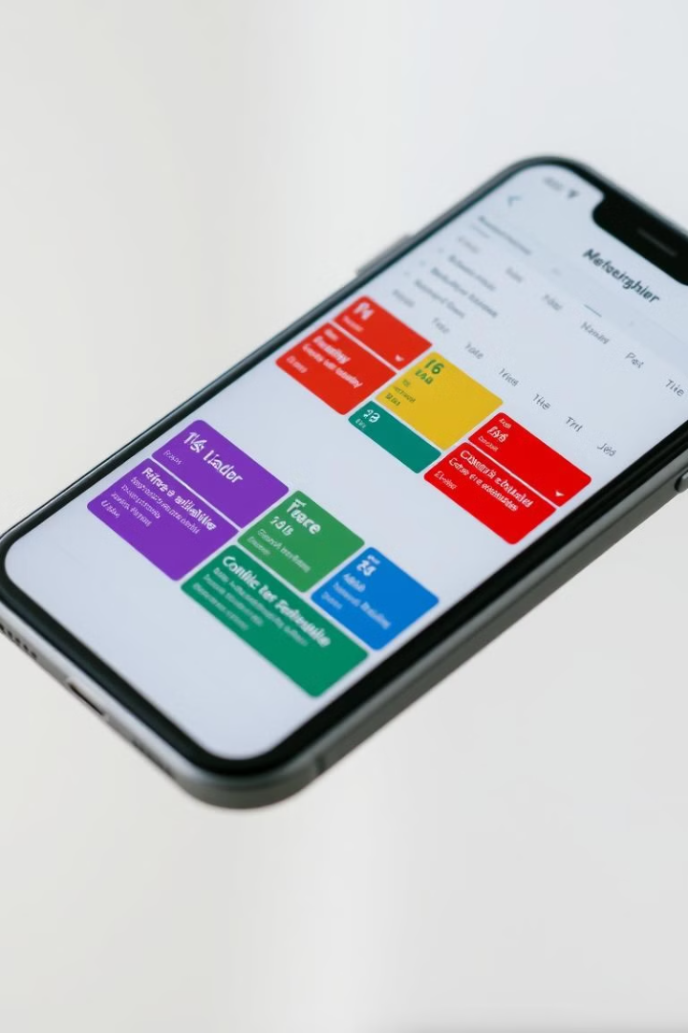
Scheduling and Availability Management
The system will provide an intuitive interface for managing referee availability and scheduling game assignments efficiently.
1
Availability Input
Referees can easily input their availability, specifying preferred dates, times, and sports.
2
Automated Scheduling
The system automatically assigns referees to games based on availability, qualifications, and preferred sports.
3
Conflict Resolution
The system identifies and resolves scheduling conflicts, minimizing manual intervention and ensuring efficient assignment.

Slide 8

1
Automated Scheduling: AI will automate schedule creation, reducing the need for manual assignments.
Integration with External Systems: Syncing external calendars (e.g., Google Calendar) will help referees manage schedules effectively.
Predictive Analytics: Systems will predict scheduling conflicts and referee fatigue to offer early solutions
2
3

Slide 9

Conclusion
In conclusion, the Referee Scheduling System efficiently manages referee assignments, feedback, and game scheduling using Object-Oriented Programming. It handles CRUD operations for referees, games, and feedback while ensuring referees are assigned based on availability and expertise. With built-in unit tests, the system is reliable and scalable, making it adaptable for future enhancements, such as advanced scheduling algorithms or feedback analytics. This proof of concept provides a streamlined solution for optimizing referee management and game operations.

Slide 10

Reference
1. https://ref-scheduler.apponic.com/
2. https://github.com/ahundiak/zayso
3. https://www.refereeschedule.com/

Slide 11


